Slide 1

BME 354 Introduction to Microcontrollers
Oliver Fang & Will Scheideler
Notes:
I’m sure you will all get different mileage out of this course, and this lecture will be the same case. I realize many of you come from different backgrounds, some of you may be ECE’s with a strong background in programming, others may be BME’s with lesser interest. Whatever the case, I hope this lecture and the series of tutorials we will be putting up will generate some interest in microcontrollers or help you learn something cool.
As you know, this class integrates many concepts from electrical engineering and biomedical engineering, from circuit design to signal processing. This semester, we are putting a greater emphasis on microcontrollers and embedded programming. Today, almost every electronic device around you, uses some sort of microcontroller. And so, for the first time, BME 354 is going to introduce a final project that uses the Arduino Uno, a hardware platform that uses a microcontroller.

Slide 2
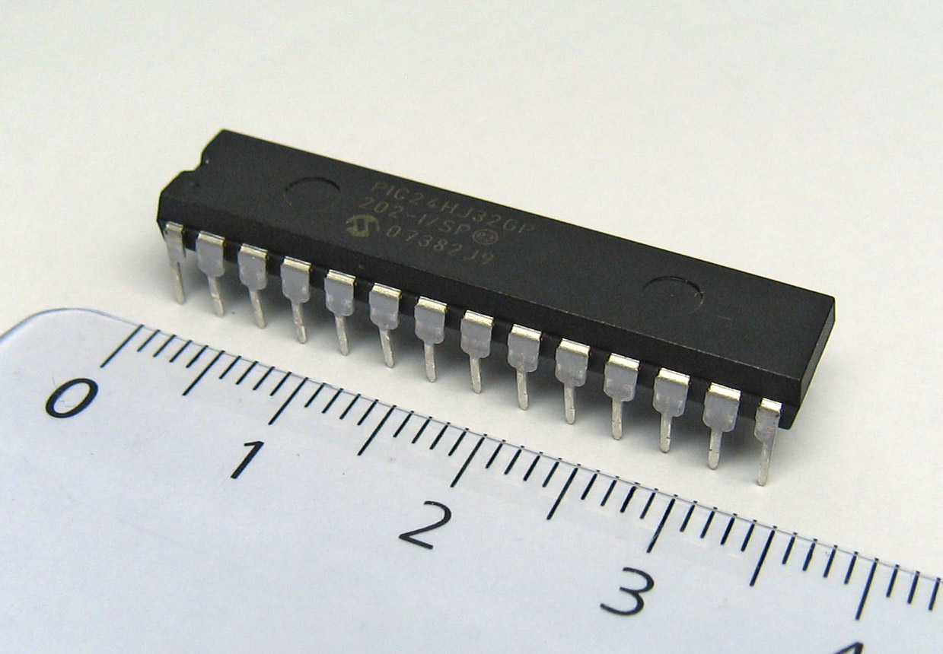
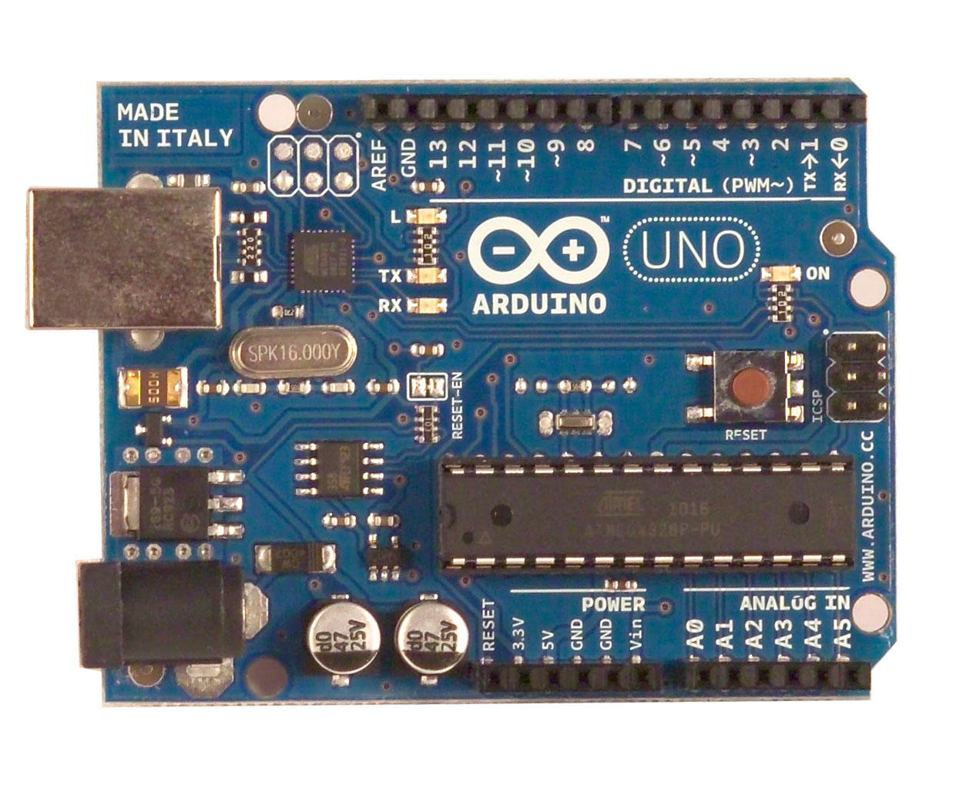
What is a microcontroller?
A small computer
An integrated circuit
Notes:
A microcontroller is essentially a small computer. It is a small integrated circuit (as opposed to a circuit with discrete components, an IC has all its circuit components printed onto a single chip). As a result of being printed, IC’s are often really very small (you’ve already worked with IC’s in the form of the AD620 and LF353 op-amps).
Contains anywhere from 20k to millions of transistors.

Slide 3
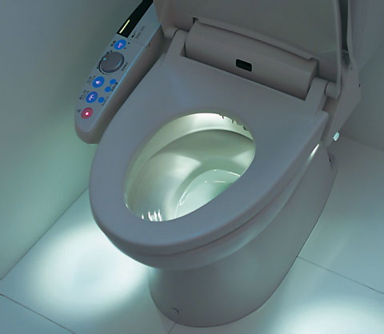

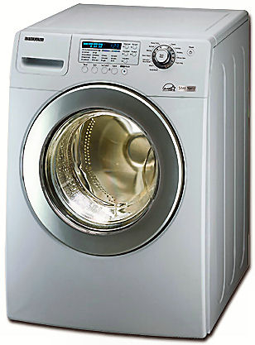
What is a microcontroller used for? Embedded applications
What are embedded systems?
Computer system optimized for a specific task
Consumer electronics
Remote control, watches, mp3 players, appliances, toys, lighting systems, Japanese toilets, etc.
Notes:
In contrast to the microprocessors used in say your laptop, microcontrollers are designed for embedded applications, this means they usually perform a very specific task.
Consumer electronics – you will find these inside remote controls, watches, mp3 players, all types of appliances.

Slide 4
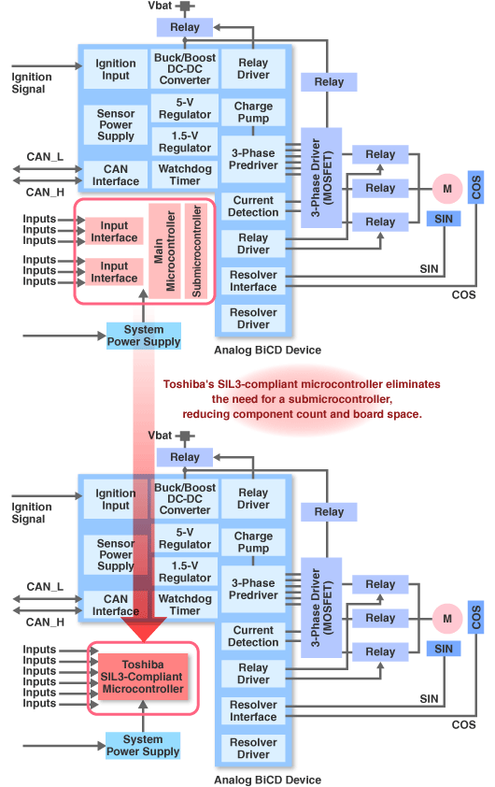
What is a microcontroller used for? A wide range of applications
Infrastructure
Telecommunication systems, traffic lights
Transportation
Cars (breaking system, power steering, radio, safety features), airplanes (GPS, safety)
Notes:
Infrastucture, so things like telephone switches, traffic lights.
Transportation, so things like the braking system or power steering system inside your car.

Slide 5

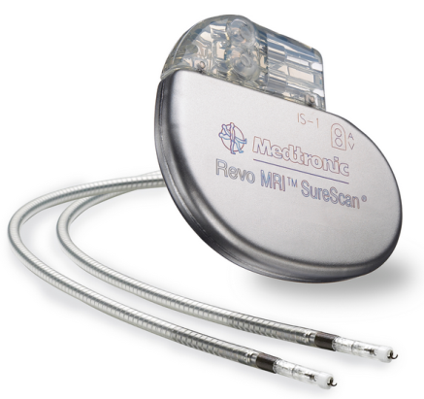
What is a microcontroller used for? Medical devices
Low Power Devices (i.e. Implantable)
Low Cost Devices
Pacemaker
Glucometer

Slide 6
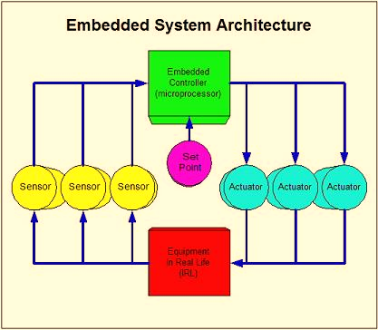
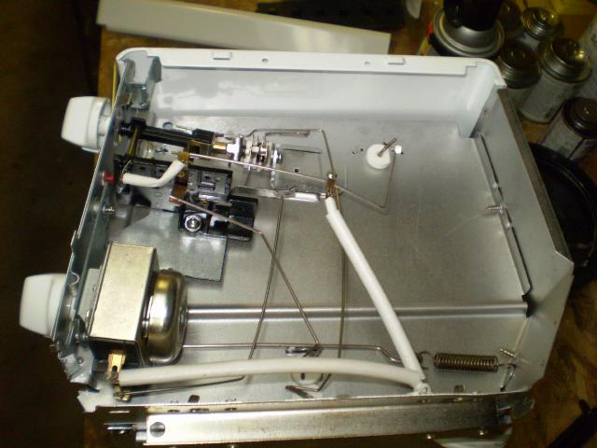
Why use microcontrollers? Flexible use in Embedded Systems
Large variety / very specialized.
Reprogrammable
Designing Control Systems
Automation
User input
Notes:
W

Slide 7
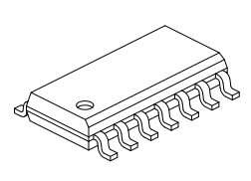
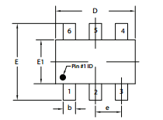
Why use microcontrollers? Low power, low cost, low space real estate
Low Supply Voltages → Portable Devices
Sleep Current ~ 20 nA
Operating Current ~ 10 µA - 100 µA
Dedicated Low Power Modes
µWatts
PIC16F1854
ATtiny6
2mm
0.95 g
y6
4mm

Slide 8
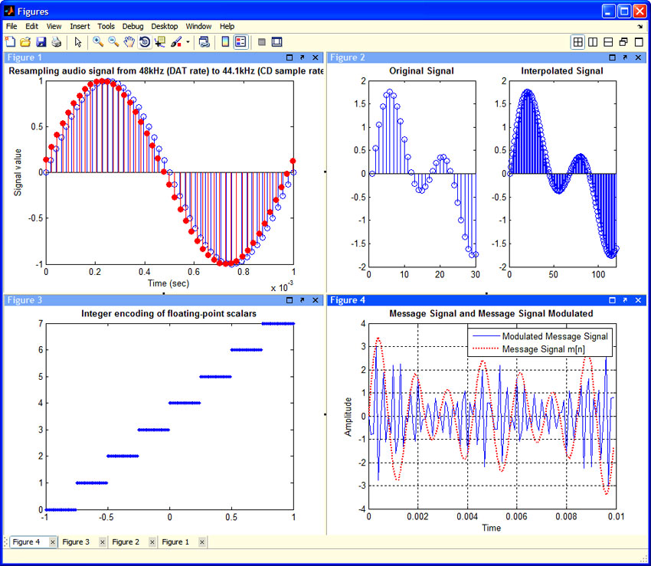
Why use microcontrollers? Limitations
Small DATA (on-board memory is limited ~ kB)
Relatively Slow (1-100 MHz)

Slide 9
How does a microcontroller work?
Executes a program that is stored on the microcontroller’s memory
1 You write code on your computer
2 Compiler converts it into code the Arduino can understand
3 Load onto microcontroller
4 Bootloader begins executing the program
5 Software interacts with hardware components
Notes:
So by now we’ve established that microcontrollers are extremely useful and are seen everywhere. So how do they work?
Runs a program that is stored in the microcontroller.
Add a diagram

Slide 10
Parts of a microcontroller Common Terms
Supply Voltage (1.8 V – 5.5 V)
How to power your device?
Frequency/Clock
# operations per second (Computational Power)
I/O Pins (Digital & Analog)
Input a Voltage Signal
Output a Voltage Signal

Slide 11
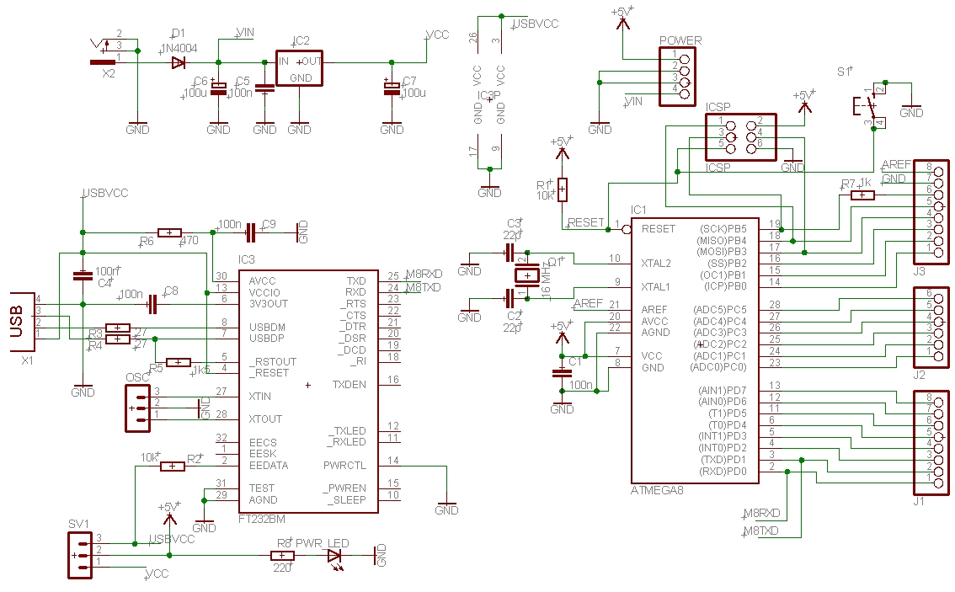
Parts of a microcontroller On board hardware
This will be left as an exercise for you

Slide 12
Parts of a microcontroller Input and Output
Digital
Input
HIGH voltage → 1, LOW voltage → 0
Output
1 → HIGH Voltage (V_{DD}), 0 → LOW Voltage(0 V)
Analog
Input: ADC (Convert V_{in} to digital word)
Output: DAC (Convert digital word to V_{out})

Slide 13
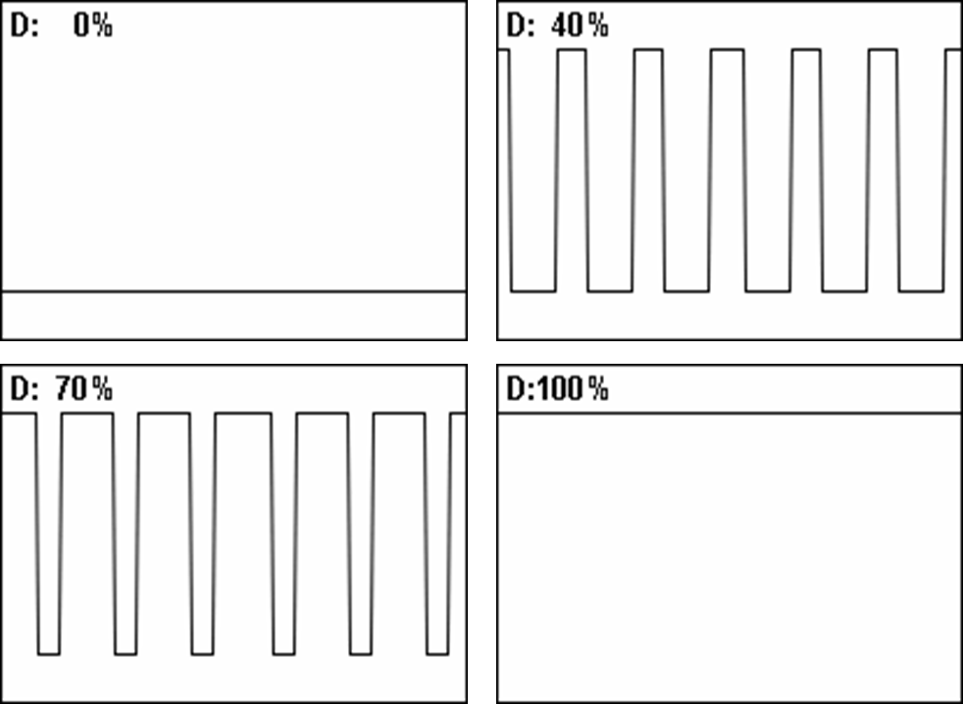
Parts of a microcontroller Pulse width modulation
PWM is useful for power electronics:
Switched-Mode Converters
DC – AC Inverters

Slide 14
Parts of a microcontroller Memory
Flash
Stores program and bootloader
Non-volatile
EEPROM
Stores long-term information
Non-volatile
SRAM
Like “RAM” for your microcontroller
Volatile
Notes:
Flash memory is kind of like the hard drive on your computer. It’s non-volatile memory, meaning that when you turn the power off, the data stored in this memory will not be erased. This is where the program and your variables are stored.
EEPROM – This is also nonvolatile memory. It is used to store long term information. It can only be accessed using read() and write().
SRAM – This is like the ram in your computer, so it is volatile memory, meaning that it will be cleared if your turn the power off. It is used by the Arduino to perform calculations and operations on your variables.

Slide 15
What is computer programming?
A way to convert your thoughts into a form that a computer can understand
How does a computer do this?
There are literally hundred of programming languages, each with their own sets of primitives, and their own special applications
Notes:
Computer programming is a way to convert your thoughts into a form that a computer can understand.
How does a computer do this? Well a computer isn’t very smart, so you have to tell it exactly what to do. A computer program is just a series of instructions. These instructions carry out your thoughts by breaking them down into chunks that the computer understands.
So let’s say you want the computer to solve a problem for you. You want the computer to find the square root of a number.
Give the computer a number. N. The computer will make a guess. G.
If G squared is approximately equal to the number, then you’re done!
If it isn’t, make another guess.
Repeat.
Now this isn’t a very smart program. So maybe you want to tell the computer to make smarter guesses. Luckily, the Babylonians came up with a good formula to do this.
The new guess is going to be equal to:
G = (G + N/G)/2
Now repeat.
Explain how a computer works. Now this looks awfully similar to what we just did.
This is all computer programming is, just you telling the computer what to do. However, just like you don’t expect someone to know to bake a cake, you can’t expect a computer to know how to do just anything. You have to break down what you want the computer to do into steps that it can understand, and we will call these things primitives.
In terms of baking a cake, these primitives will be things like, add some ingredient, mix, preheat. In computer programming, the set of primitives you can use is defined by the programming language that you are using.
There are literally hundreds of programming languages, each with their own set of primitives. Now a lot of these overlap, because whoever made these programming language thought that some things would all be convenient to have. For example, in pretty much every programming language, you can add 2 numbers together.
Now, because they have their own set of primitives, this makes some programming languages better than others for certain applications.

Slide 16
Examples of programming languages
Web development - Javascript/HTML/PHP
Mathematical computation – Scala/Haskell
Databases/servers – Ruby on Rails/PHP
Lower level programming – C
Scripting – Perl/Python
iPhone applications – Objective C
However, there is nothing you can do in one language that you cannot implement in another!
Notes:
Some are more useful than others. But there is no best programming language

Slide 17



Intro to programming
High Level Language
Assembly Language
High abstraction, easier to use
A richer set of primitives
Understandable by humans
Not directly understood by computers, which only understand 0 and 1
Machine Language
Hardware
Notes:
So first lets talk about high level programming languages. These are the ones you will probably think of when someone says programming language. Things like Java, Python, C/C++.
High level languages have a high level of abstraction. This means that the set of primitives they use is pretty different from the set of primitives that a computer can directly understand. This is done to make programming in high level languages more understandable to humans and thus easier to work with. Some languages, such as python, have such a high level of abstraction that it can almost be read like English.
Here I just want to mention again that the computer cannot understand the high level of abstraction in these languages. It can only understand 0’s and 1’s.

Slide 18
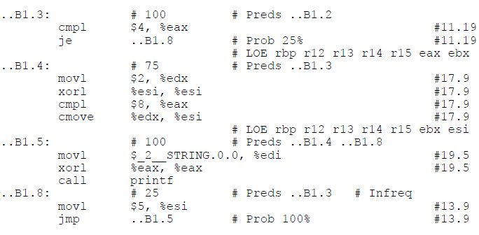
Intro to programming
High Level Language
Assembly Language
Lower level language
Far less abstraction
Corresponds directly with processor
Used before high level languages
Still used for direct hardware manipulation
Machine Language
Hardware
Notes:
Assembly languages are what we call lower level languages. These languages have far less abstraction in that their set of primitives corresponds almost directly with actions that the processor, the computer, can understand.
These were the first programming languages created before high level languages. Now, most people have switched to using high level languages simply because they are more powerful and far easier to code in. However, there are still some applications for assembly programming. It allows the programmer to know exactly what is happening on a hardware level, and thus is useful for direct hardware manipulation.

Slide 19
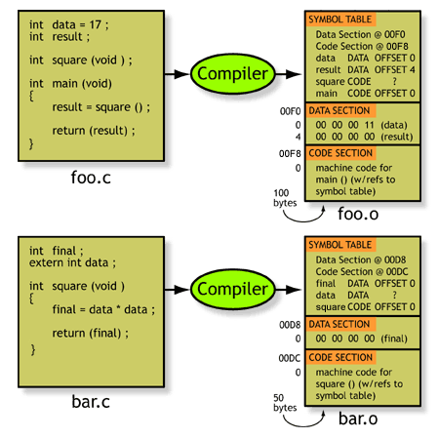
Intro to programming
High Level Language
Assembly Language
Machine Language
Instructions are entirely in 0’s and 1’s
A compiler, interpreter, or assembler translates a high level or assembly language into machine language
Hardware
Notes:
The “primitives” of machine languages are instructions that are entirely composed of 0’s and 1’s – things that the computer can understand. Different combinations of 0’s and 1’s represent different instructions, and the computer will know what to do based on these instructions.
No one actually codes in machine language. Instead, we write high level code or low level code, and use tools called compilers, interpreters, and assemblers to convert them into machine code language.

Slide 20
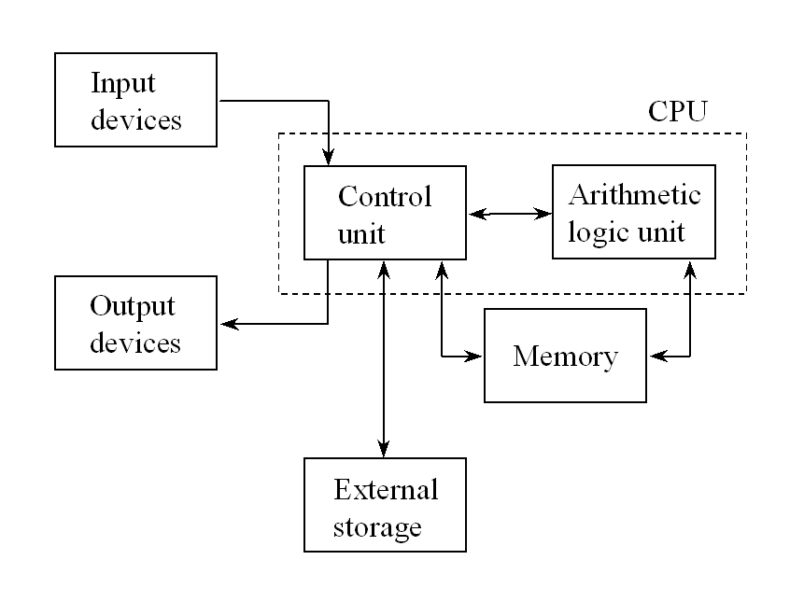
Intro to programming
High Level Language
Assembly Language
A computer processor executes the instructions in the machine code
Basic mathematical/logical operations
Store/move/load things into memory
Program control – jump and branch
Interface with input/output devices
Machine Language
Hardware
Notes:
So I already briefly went over this, but here you can see the parts of a computer. There is the control unit, the arithmetic logic unit, and memory. In addition, you see external storage, this is like the hard drive. And you also have input and output devices. These are things like a monitor, a keyboard, a mouse, a wifi antenna that the computer is able to interface with.
A typical processor can usually do a couple of things. It can do basic mathematical or logical operations – such as adding, subtracting, shifting, and/or, etc.
It can store, move, and load things into and out of memory.
It can jump around in the program. Remember the program counter? Well certain instructions allow you to change the value of the program counter, essentially allowing you to move to a different part of the code. Another type of instruction, called branching allows you to jump conditionally. This instruction forms the basis of conditional statements and allows the computer to make decisions.
Lastly, a computer is able to talk to input and output devices. It can know when a key was pressed on the keyboard, and it can send data to a monitor to display that text.

Slide 21
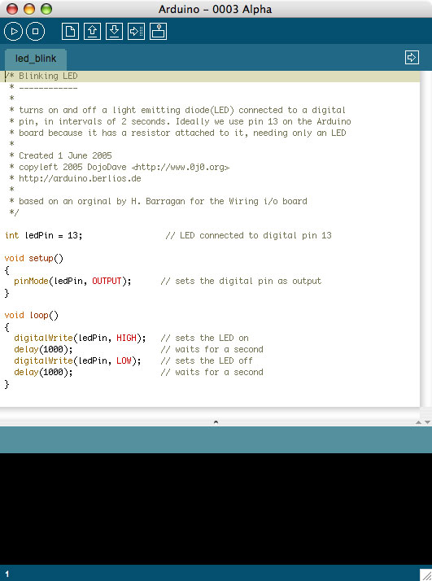
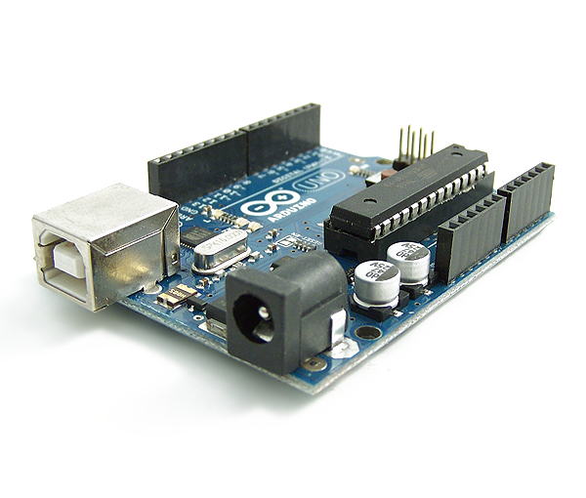
Why Arduino? Great for learning electronics and designing projects
Great for learning, C++
Simple to interface with
Notes:
So why Arduino?
1. Arduino is a great board to learn embedded programming on. It is based on the C++ programming language, but hides a lot of the technical stuff from the user. As such, it is very easy to get up and running. The whole vision of the Arduino line of development boards was that it could allow anyone to easily pick up and build cool electronics. That said, while it is a good introduction to design and a quick way to build cool stuff, it won’t teach you a lot of the technical details that you have to really muck around with in other microcontrollers such as PIC or AVR. So just know its limitations.
2. It is very simple to interface with. Whereas the PIC would require you to download MPLAB, which is quite a heavy Integrated Developing Environment (IDE), Arduino’s text editor like IDE is very lightweight and simple. Additionally, there is no need for an additional programmer; Arduino simply interfaces with USB. Again, this goes with the whole “easy to pick up” theme.

Slide 22
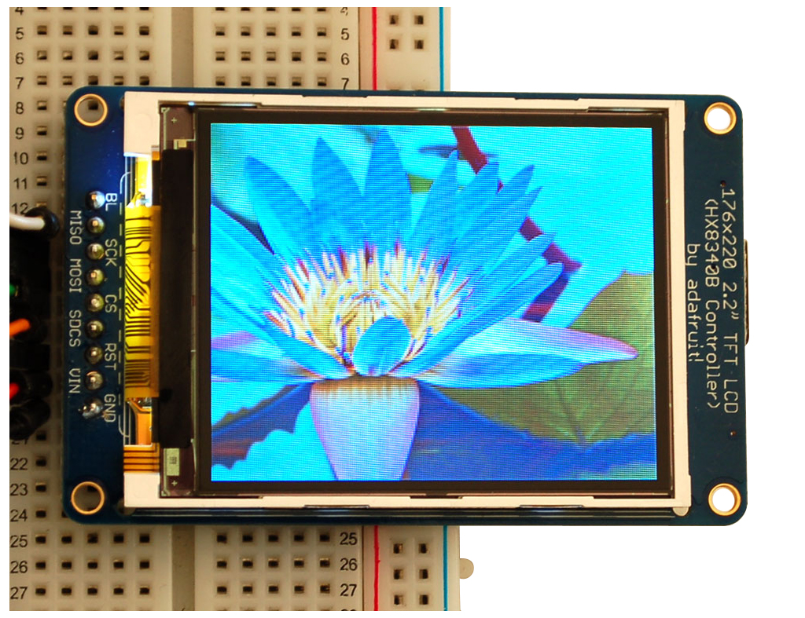
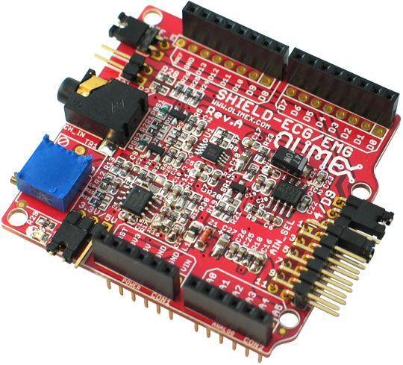
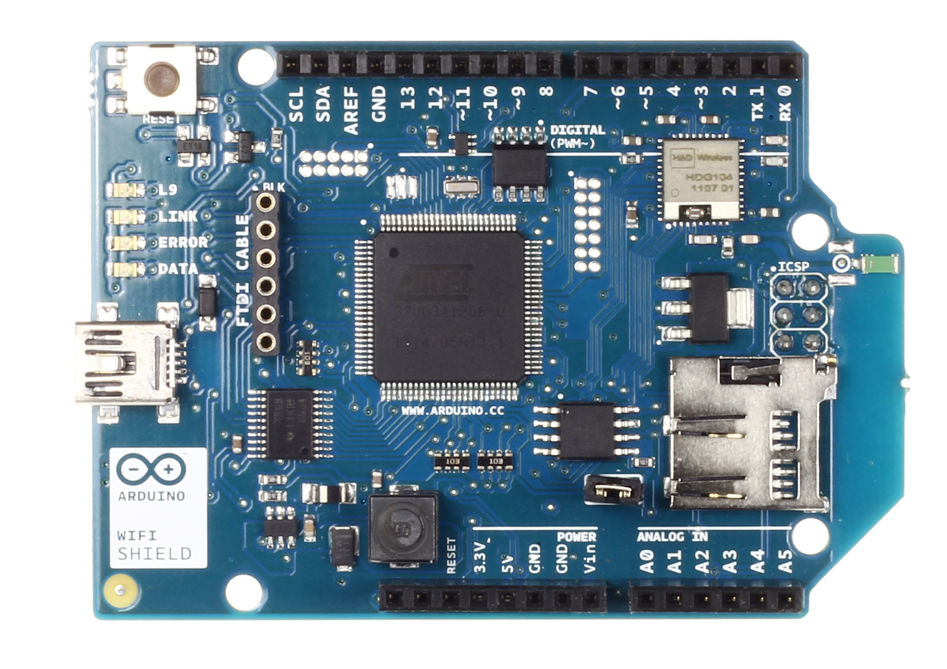
Why Arduino? Vast amount of hardware and software support
Hardware support
Open-source and software support
http://thinkering.npage.de/arduino-microcontroller/portable-ecg-monitor.html#
Notes:
3. There is a lot of hardware support for the Arduino. Many companies sell shields that increase the hardware capabilities of the Arduino so the user doesn’t have to build hardware for common tasks. For example, there are LCD shields for displaying text and numbers, there are Ethernet shields and Wifi shields for connecting to the Internet, and there are audio shields to play high quality music.
4. Lastly, and most importantly, there is a huge amount of open source software available online. The massive user base contributes a lot of code for common functions to entire projects. People have made electronic instruments, light-up clothing and costumes, automate household appliances, and even medical devices and much, much more. If you are interested, take a look online and see what people have made, some of these projects are really cool.

Slide 23
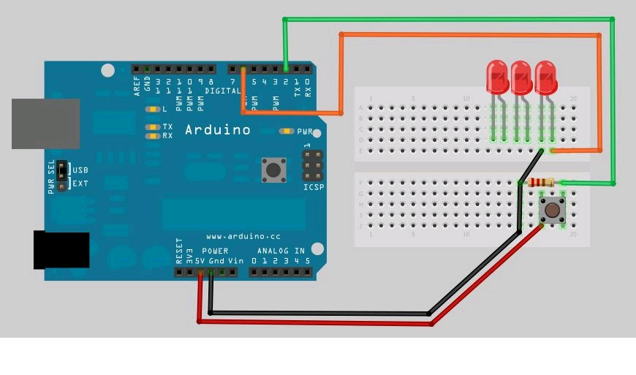
Demo Pushbutton counter

Slide 24
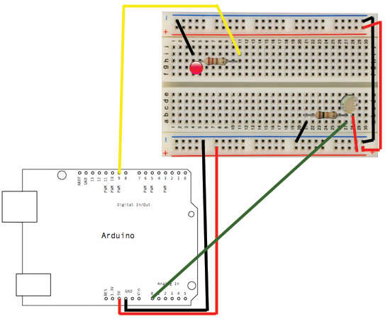
Demo Night light

Slide 25
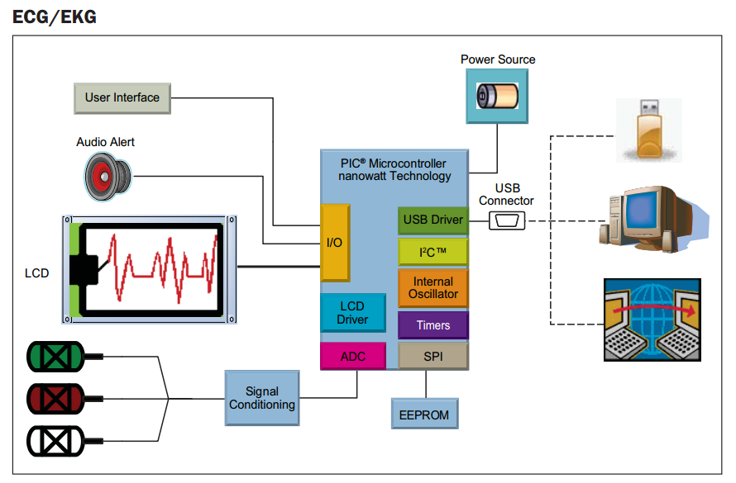
What is a microcontroller used for? Medical devices

Slide 26
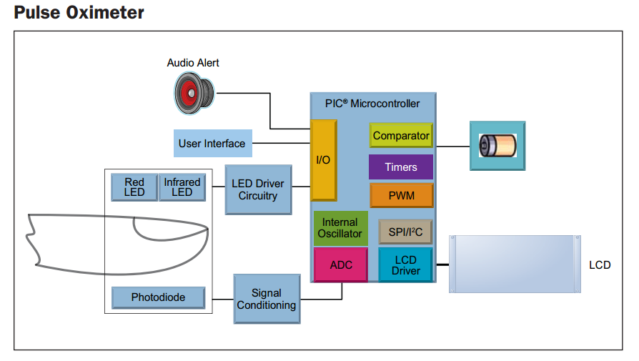
What is a microcontroller used for? Medical devices

Slide 27
Videos
Beer Launching Fridge
Laser Harp
Animatronic Lamp

